Slide 1
A Brief Introduction to Neural Networks

Slide 2
Me
Robert Slater
Data Scientist at Capital One
I work on NLP
I compete with Google, Facebook, Amazon.
PhD Physics 2001
rslater@smu.edu
9728375072
I respond to texts and emails fairly fast, but I also lose track. If you go 24 hours after asking me something ASK AGAIN (aka I forgot to respond)
Weekends are hit and miss
Office hours Thursday or by appointment.

Slide 3
Homework Policy
Contrary to Syllabus Homework is due the night of class at 11:30PM with a 30 min grace period.
Class on Monday? HW Due 11:30 PM Central on Monday
Class on Tuesday? HW Due 11:30 PM Central on Tuesday.
What’s with the weird grace period? Clarity. Rather than say 11:59.9999999
I.E. Your homework must be timestamped with the day your class occurs on IN MY TIME ZONE. (CENTRAL)

Slide 4
Attendance Policy
Show up for every class
You may be excused if planned in advance
More advanced notice, less irritating professor
Less Advance notice, more irritating professor.
Get 100% for attendance. EASY MONEY

Slide 5
Exceptions
Family Emergencies
Unplanned Work Trips
Locusts
Planned Trips (in Advance)
If you are taking Vacation in March, tell me ahead of time!!!
I hate surprises. “I had to take my son to the ER Professor!”
The amount of collateral damage caused by my class is incacluable…
(I am not heartless, its just students made me that way).

Slide 6
Grade Policy
90+ A
80+ B
70+ C
60+ D
50+ F
Attendance counts.
Watching Videos Counts
Homework Counts

Slide 7
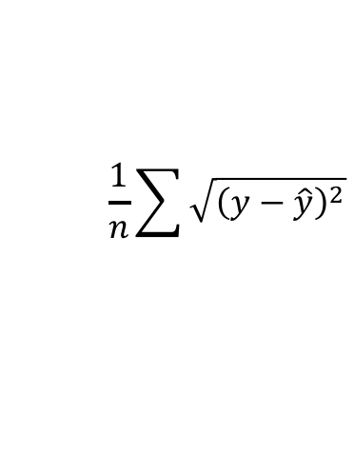

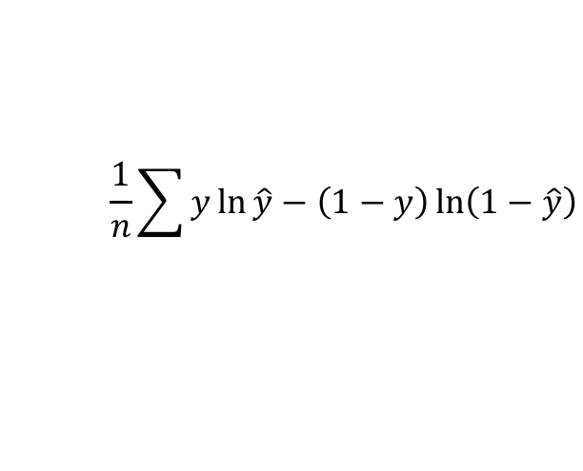

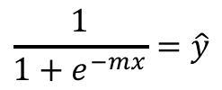
Start with a regressor
$$m x+b= \hat{y}$$
Subject to
$$\frac{1}{n}\sum{\sqrt{{\left(y−\hat{y}\right)}^{2}}}$$
m, x are MATRICIES (keep that in back of your mind)
Linear to Logistic
$$\frac{1}{1+e^{−mx}}=\hat{y}$$
$f(z)=\hat{y}$, z = mx
Subject to
$$\frac{1}{n}\sum{y\ln{\hat{y}−\left(1−y\right)\ln\left(1−\hat{y}\right)}}$$

Slide 8

Neural Net with 1 node
b, typically not shown
f(z) is the activation function. It can be the sigmoid (logistic regression), Identity (linear regression) or another
Note that often regressors have x₀ = 1 and m₀ = b, neural nets D0 NOT follow this convention
x₁
x₂
Typical view, no b
No activation (it is implied)
x₃
m
x₂
x₄
$$\hat{y}=f\left(z\right), z=mx+b$$
x₃
x₅
x₄
x₅
m has 5 values (1 for each x). Thus the matrix multiplication of mx has dimensions (5 x 1)(1 x 5) = (1 x 1)
f(z) is called element-wise and a thus b is (1x1) since mx is 1x1

Slide 9


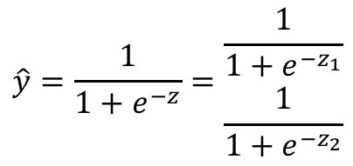
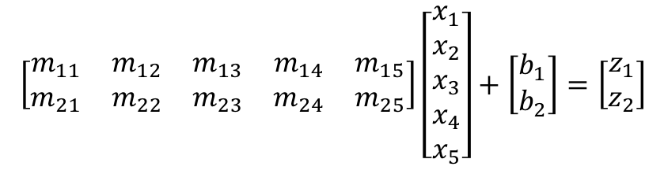

So each ‘DOT’ in a neural net is a regressor
x₁
Still
$$\hat{y}=f\left(z\right), z=mx+b$$
x₂
$$\hat{y_{1}}=f\left(z\right), z_{1}=m_{1}x+b_{1}$$
x₃
$$\left[\begin{matrix}m_{11} & m_{12} & m_{13} & m_{14} & m_{15} \\ m_{21} & m_{22} & m_{23} & m_{24} & m_{25}\end{matrix}\right]\left[\begin{matrix}x_{1} \\ x_{2} \\ x_{3} \\ x_{4} \\ x_{5}\end{matrix}\right]+\left[\begin{matrix}b_{1} \\ b_{2}\end{matrix}\right]=\left[\begin{matrix}z_{1} \\ z_{2}\end{matrix}\right]$$
x₄
$$\hat{y_{2}}=f\left(z\right), z_{2}=m_{2}x+b_{2}$$
x₅
$$\hat{y}=\frac{1}{1+e^{−z}}=\begin{matrix}\frac{1}{1+e^{{−z}_{1}}} \\ \frac{1}{1+e^{{−z}_{2}}}\end{matrix}$$

Slide 10
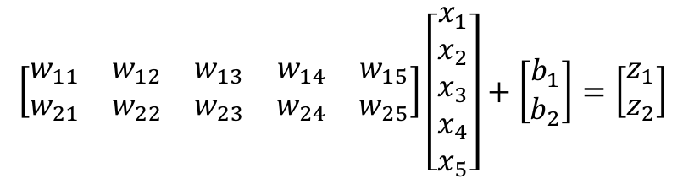
Change of notation, m to w (for weights)
$$\left[\begin{matrix}w_{11} & w_{12} & w_{13} & w_{14} & w_{15} \\ w_{21} & w_{22} & w_{23} & w_{24} & w_{25}\end{matrix}\right]\left[\begin{matrix}x_{1} \\ x_{2} \\ x_{3} \\ x_{4} \\ x_{5}\end{matrix}\right]+\left[\begin{matrix}b_{1} \\ b_{2}\end{matrix}\right]=\left[\begin{matrix}z_{1} \\ z_{2}\end{matrix}\right]$$
This is a single layer neural network, solved by minimizing the loss.

Slide 11
What are the dimensions of the input?
What are the dimensions of the Hidden Layer Weights?
What are the dimensions of the output layer weights?
What are the dimensions of the ‘inputs’ to the outputs
What is missing?
Hidden Layer
Input
outputs

Slide 12
Answers
Inputs are 1 x 4
Hidden Layer Weights are 4 x 5
Output layer Inputs are 1 x 5
Output layer weights are 5 x 3
Final outputs are 1 x 3
Missing the bias hidden layer (1x5), output layer (1,3).
Activation functions!

Slide 13






O Crap Multiple Layers
$$z_{1}=f(w_{1}x+b_{1})$$
$$z_{2}=f(w_{2}z_{1}+b_{2})$$
x
$$z_{3}=f(w_{3}z_{2}+b_{3})$$
$$z_{1}$$
$$\hat{y}=f(w_{3}∙f\left(w_{2}∙f\left(w_{1}x+b_{1}\right)+b_{2}\right)+b_{3})$$
$$z_{2}$$
$$z_{3}$$

Slide 14
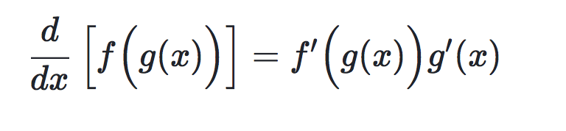
Calculus—o bother (Chain rule)
Small delta
Small delta
Small x Small = REALLY SMALL

Slide 15
How to configure?
People like even numbers (100, 150)
Powers of 2 (512, 1024)
Rules of thumb
ITS ALL LIES
Architecture is a parameter to be tuned, there is no guide. More often goverened by time and resources (more layers, nodes, longer training)

Slide 16
Experiment
Why do word vectors have ~100 to 300 dimensions
Why do neural nets ‘shrink’ with more layers?
Which activation works best?

Slide 17
Activations
Standard
Sigmoid, Tanh, ReLu, Linear
Exotic
eLu, GeLu
Final output typically is linear or sigmoid based on problem
Hidden layer experiments favor ReLU, GeLU
https://en.wikipedia.org/wiki/Activation_function

Slide 18
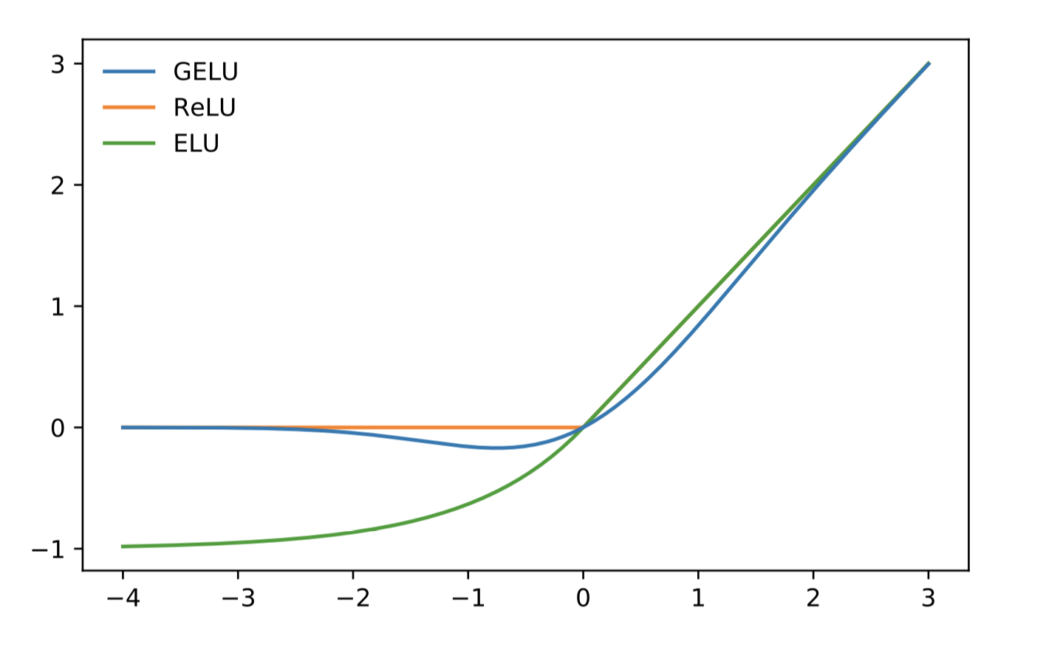
GeLU (regularization + activation)

Slide 19
Other Tricks: Dropout
While training, ‘drop’ a percentage of connections. Prevents Overfitting, promotes ‘strong’ connections.
x
$$z_{1}$$
$$z_{2}$$
$$z_{3}$$

Slide 20
Optimizers? What are they
How you solve the previous equations to learn w, b.
TLDR: Uses an advanced optimizer like rmsprop or adam.
Gradient Descent is fine but SLOW.
Main knob is your learning rate, along with architecture.
Don’t play with optimizer constants unless you REALLY know what you are doing.

Slide 21
Takeaways
Understand the Weight sizes
Architecture is a hyperparamter
Use ReLU or GeLU for hidden layer
Neural Net is an ensemble of regressors
Final output can be sigmoids, linear, etc depending on your problem,.

